Slide 1
The Way + CuBIDS
An overview of the PennLINC Informatics Team’s method for curating and preprocessing large BIDS datasets

Slide 2
Defining “The Way”
The PennLINC Way documents standard practices we’ve developed while working with lots of diverse data. The goal is to have a accurately-curated, provenance-tracked, usable data set as a basis for studies.
This presentation follows up on Sydney’s presentation from last week. How do you reproducibly run pipelines on your cubids-refined data?

Slide 3
Running Pipelines with Datalad
Running pipelines should be simple and reproducible once BIDS is good
We want to capture
State of the input (BIDS) data
The exact container used to run the pipeline
The exact command used to run the pipeline
Who ran it and when
We want to be able to transfer data and provenance
Easily
Efficiently
Together

Slide 4
Simplicity
Our workflow uses “bootstrap” scripts for each pipeline
Based on Datalad authors’ approach for UK-Biobank
Won’t need to change for small or VERY large datasets
Documented on pennlinc.github.io

Slide 5
Background: Datalad tracked pipeline runs
v2
Result
v1
Code/
participant_job.sh
pipeline_zip.sh
submit_jobs.sh
Code/
participant_job.sh
pipeline_zip.sh
submit_jobs.sh
sub-1
inputs/data/
sub-1/
sub-2
sub-3
inputs/data/
sub-1/
sub-2
sub-3
container_dataset
container_dataset
sub-1
Run job for sub-1

Slide 6
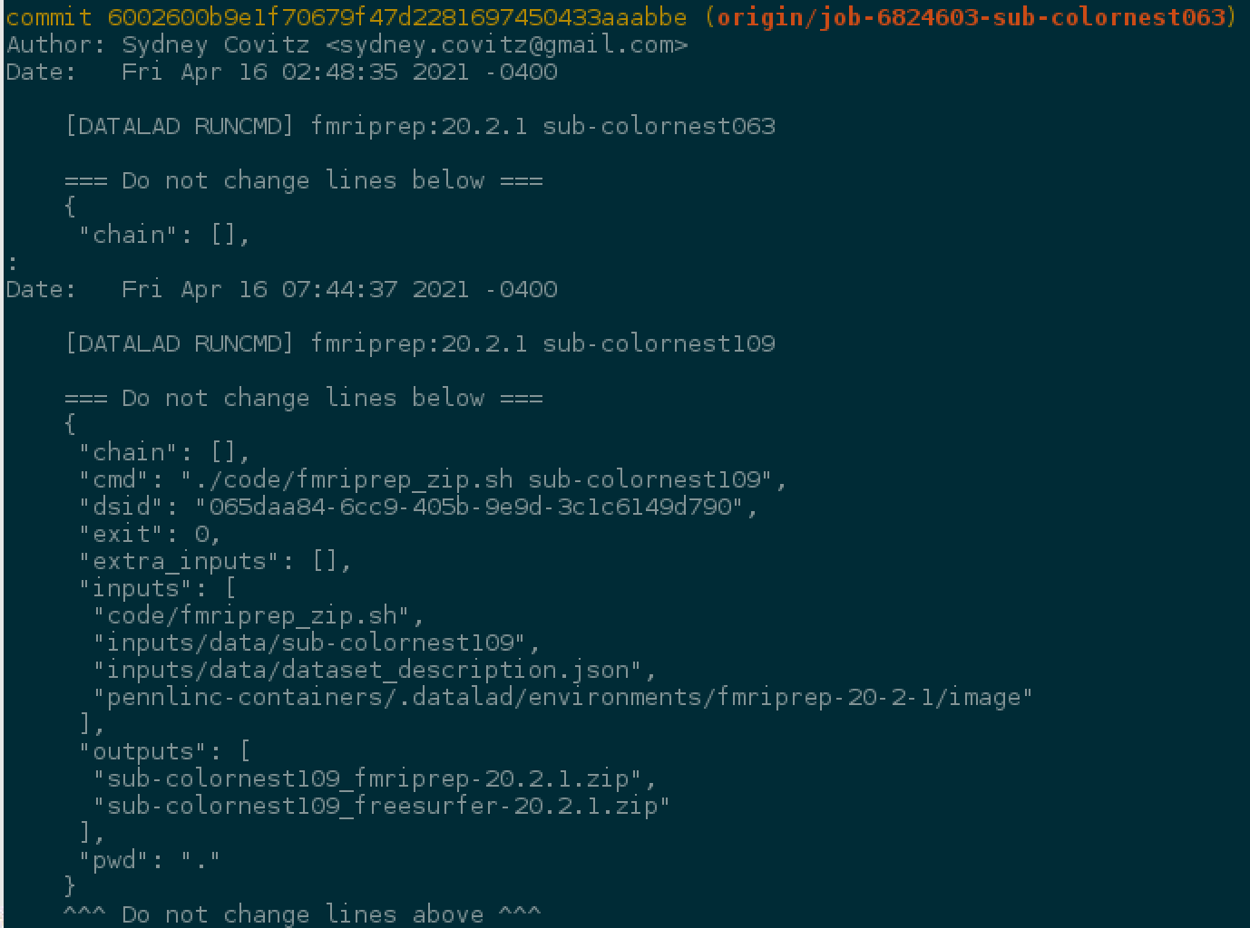
Provenance
Author, Date
EXACT state of input data
Input files used
Files created by this run

Slide 7
Background: Datalad tracked pipeline runs
v1
v2
v3
v4
Running in serial: No problem
v1→v2
v2→v3
v3→v4

Slide 8
Background: Datalad tracked pipeline runs
Concurrency causes
problems.
What will the input look
like by the time we run
the analysis?
v?→v3
v?→v4
v?→v2

Slide 9
v1
Normal datalad dataset with
code and inputs. No outputs
v1
v4
v1→v2
Input Store
v1→v3
Output Store
v1→v4

Slide 10

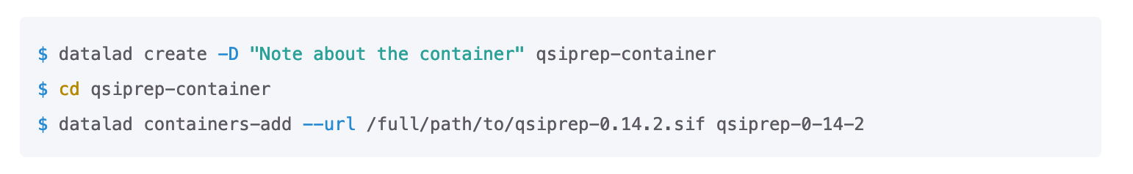

Slide 11
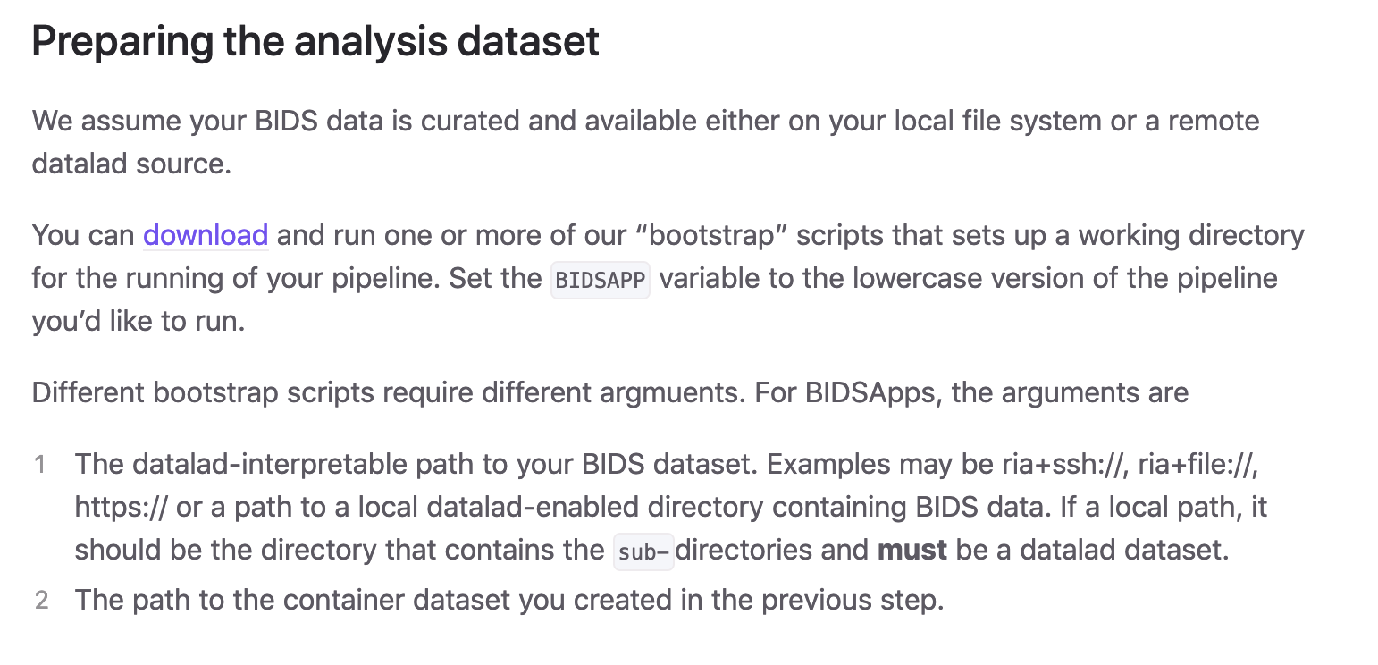

Slide 12
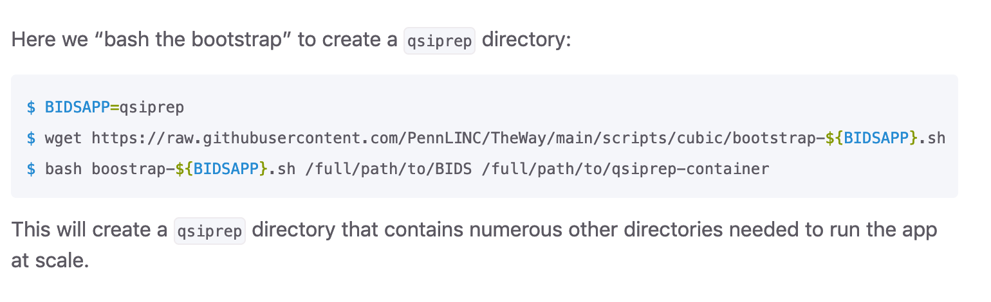

Slide 13
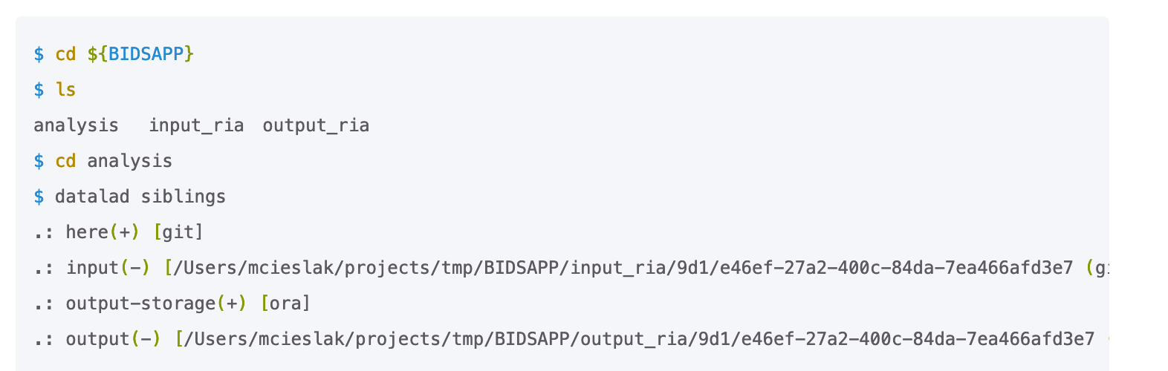
Analysis dataset: content

Slide 14
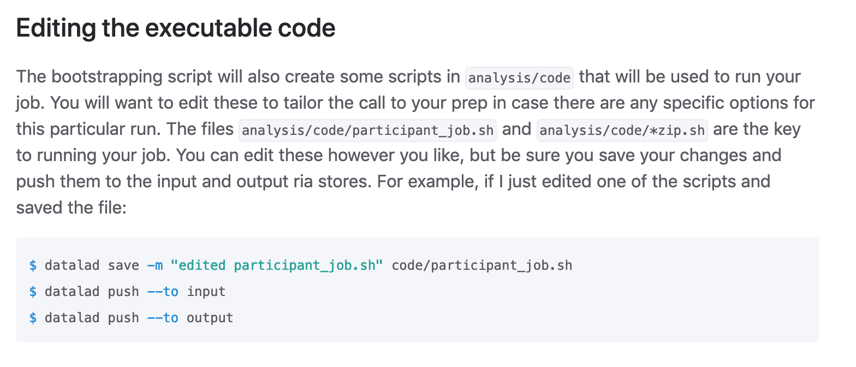

Slide 15
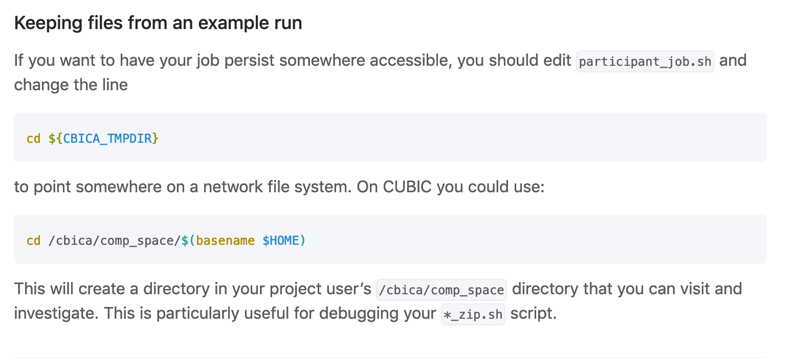

Slide 16
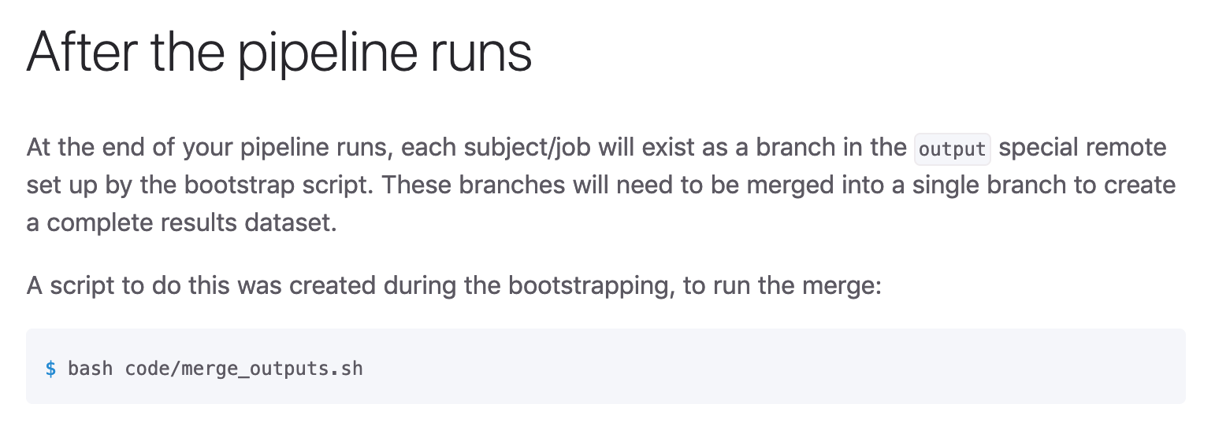

Slide 17
Bootstrap use
Download a script that
sets up the input and output store
initializes the analysis dataset
sets up the submit scripts
Point the script to
Your BIDS data
The container you want to use
Run it!
Collect your outputs
Feed them to as input to another bootstrap

Slide 18
Example:
Valid BIDS
Your data is officially
BIDS-valid
Checked in to datalad
This does not guarantee that it will be processed correctly by the BIDS App
Fieldmaps might not be used
slice timing may/may not be uniformly present
How do you know the BIDS App will work?
Works as
intended in
the BIDS App

Slide 19
